Slide 1


Introduction to Vehicular Pollution
Vehicular pollution is a major environmental concern, as emissions from cars, trucks, and other vehicles contribute significantly to air quality degradation and climate change. Understanding the sources and impacts of vehicular pollution is crucial for developing effective mitigation strategies.

Slide 2
Sources of Vehicular Pollution
Exhaust emissions from internal combustion engines in cars, trucks, and buses.
Tire and brake wear releasing particulate matter into the air.
Evaporative emissions of volatile organic compounds (VOCs) from fuel systems.

Slide 3
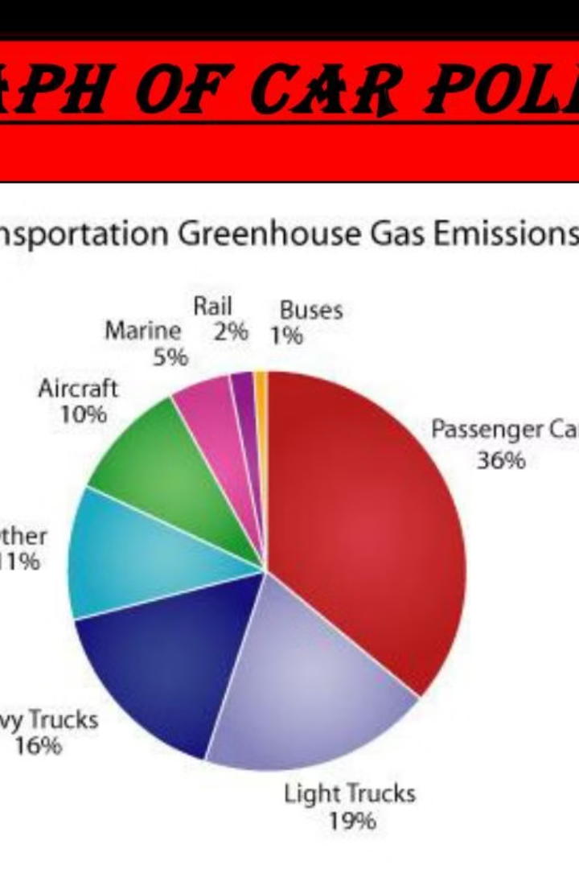
Harmful effects of vehicular pollution on the environment
Vehicular pollution is a major contributor to environmental degradation. Exhaust emissions from cars, trucks, and other vehicles release harmful pollutants like carbon monoxide, nitrogen oxides, and particulate matter into the air, contaminating the atmosphere and damaging ecosystems.
These pollutants can lead to the depletion of the ozone layer, increased acid rain, and the disruption of natural habitats, threatening the delicate balance of the environment and the well-being of all living organisms.

Slide 4
Greenhouse Gas Emissions from Vehicles
1
Carbon Dioxide (CO2) Emissions
2
Methane (CH4) Emissions
Leaks and incomplete combustion in vehicles can release methane, another powerful greenhouse gas with a higher global warming potential than CO2.
Vehicles burning fossil fuels, such as gasoline and diesel, release large amounts of carbon dioxide, a potent greenhouse gas that contributes to global warming and climate change.
3
Nitrous Oxide (N2O) Emissions
4
Impacts on the Environment
Vehicles, especially those with catalytic converters, can also emit nitrous oxide, a long-lived greenhouse gas that is approximately 300 times more potent than CO2.
These greenhouse gas emissions from vehicles contribute to climate change, leading to rising temperatures, sea level rise, extreme weather events, and disruption of ecosystems and biodiversity.

Slide 5

Impact of Vehicular Pollution on Air Quality
Vehicular emissions are a major contributor to poor air quality, particularly in urban areas with high traffic density. Pollutants like nitrogen oxides, carbon monoxide, and particulate matter can accumulate in the atmosphere, leading to smog, reduced visibility, and elevated health risks.
The impact on air quality is especially pronounced in cities with limited air circulation and high population density, where these harmful pollutants can become trapped and concentrated, exacerbating the problem.

Slide 6
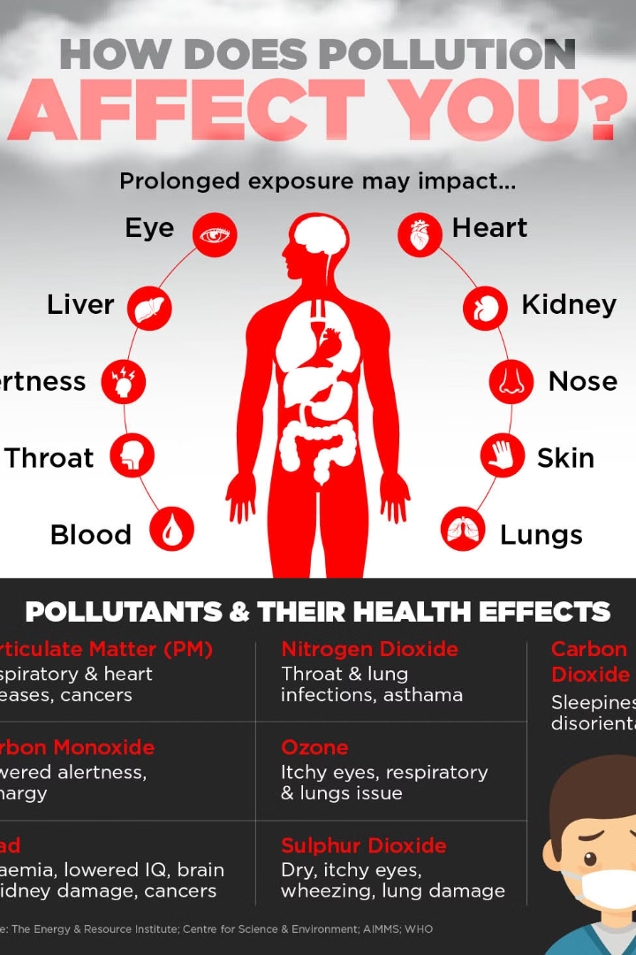
Health risks associated with vehicular pollution
Exposure to vehicle emissions can lead to severe respiratory issues, such as asthma, lung cancer, and cardiovascular diseases. Particulate matter and nitrogen oxides from vehicles can aggravate existing conditions and cause inflammation in the lungs.
Prolonged exposure to vehicular pollution has been linked to increased risk of premature death, especially among vulnerable populations like children and the elderly. The toxins can also contribute to neurological disorders and impaired cognitive function.

Slide 7




Strategies to Reduce Vehicular Pollution
Carpooling
Public Transportation
Electric Vehicles
Proper Maintenance
Sharing rides with others reduces the number of vehicles on the road, lowering overall emissions.
Transitioning to electric or hybrid vehicles significantly reduces tailpipe emissions and fossil fuel consumption.
Utilizing buses, trains, and other public transit options decreases individual vehicle usage.
Regular vehicle maintenance and tune-ups improve fuel efficiency and lower emission levels.

Slide 8

Role of Government Regulations and Policies
Emission Standards
1
Governments establish strict emission standards for vehicles to limit the release of harmful pollutants like carbon monoxide, nitrogen oxides, and particulate matter.
2
Fuel Efficiency Mandates
Policies that require automakers to improve the fuel efficiency of their vehicle fleets, encouraging the development of electric, hybrid, and more efficient internal combustion engines.
Incentives and Subsidies
3
Governments offer financial incentives and subsidies to promote the adoption of eco-friendly vehicles and the installation of charging infrastructure.

Slide 9
Importance of Public Awareness and Individual Actions
Raising Awareness
Encouraging Change
Grassroots Efforts
Policymaker Pressure
Educating the public about the harmful effects of vehicular pollution is crucial. Campaigns and outreach programs can help people understand the environmental and health risks.
Inspiring individuals to adopt eco-friendly behaviors, such as using public transportation, carpooling, or driving electric vehicles, can significantly reduce overall emissions.
Community-led initiatives, like tree-planting projects or car-free days, can raise awareness and promote sustainable practices at the local level.
Individuals can also advocate for stricter regulations and policies to curb vehicular pollution, influencing government decision-makers to take decisive action.

Slide 10
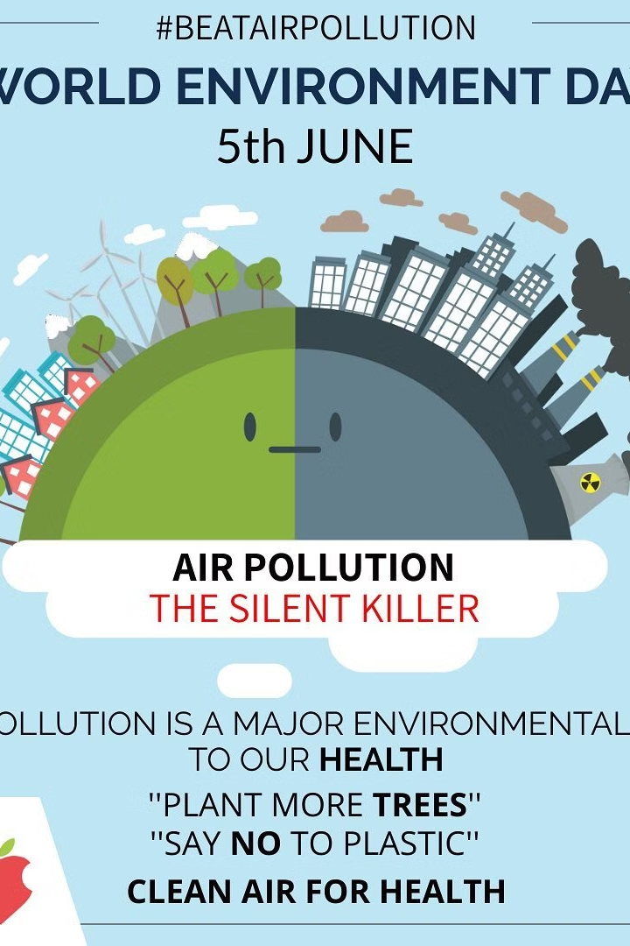
Conclusion and Call to Action
In conclusion, addressing the pressing issue of vehicular pollution is crucial for safeguarding our environment and public health. Concerted efforts by governments, industries, and individuals are necessary to implement effective strategies and drive meaningful change.

